Slide 1
Strikes 24th, 25th and 30th November
It is your future we are fighting for.
Higher education will decline rapidly if staff cannot afford to work in universities
Staff are facing massive cuts to salaries in real terms and a 35% loss in their pensions
Those on strike do not get paid for the days they are on strike
We are requesting that all wages held back by college for strikers are put into the student hardship fund.
We take the decision to go on strike very seriously, we hate having an impact on your learning.

Slide 2
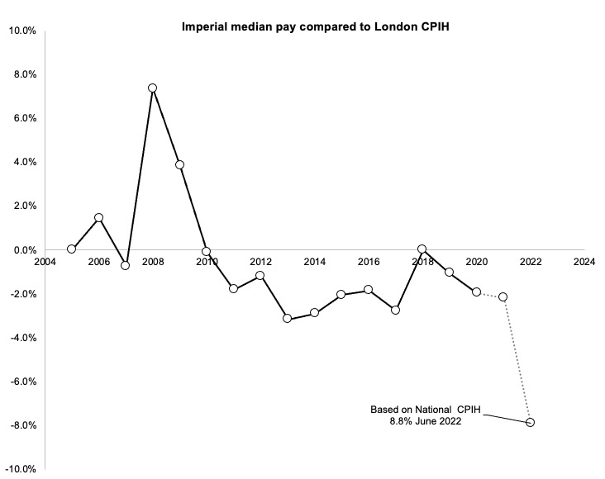
Pay
Imperial trade unions negotiate Pay directly with Imperial management.
Annual Surplus in 2021 of £162 million.
Reserves of £1,878 million.
Imperial can afford to pay us fairly but they have chosen not to.
If this continues Imperial will no longer be able to attract the best staff – directly impacting your education.

Slide 3
Pensions
USS runs the pensions on behalf of UUK (universities UK).
Valuation done in March 2020 showed huge deficit:
  Note date!
  Unrealistically prudent valuation – against JNC recommendations.
Slashing of pensions imposed on staff in 2022 ( for member under 40 this will cost them £100k-200k…more for students hoping to become British academics).
New estimates now show USS fund not in deficit after all (1.8billion surplus).
We want Imperial management to lobby UUK and USS to reverse all the cuts in the pensions.

Slide 4
What can you do to support us
Support
Support our strike & join us on the picket lines
Email
Email Provost (provost@imperial.ac.uk) and President (president@imperial.ac.uk) to ask them:
to give staff a fair pay rise.
Lobby the UUK to fight for the reversal of pension cuts.
Ask
Ask your other lecturers/personal tutors etc to support the strike for your sake.

Slide 5
Effect on LA&G
If I decide to strike I will:
  When the disputes are settled adequately, provide full set of notes (even for parts that I haven’t lectured on – but not videos).
  Not examine parts that haven’t been lectured on.
  Not skip sections but continue from where we stopped the last lecture (this may mean we do not finish the course).

